Slide 1
BANG FOR BUCK
Logo Design Ideas

Slide 2

Number 1

Slide 3

Number 2

Slide 4


Number 3

Slide 5
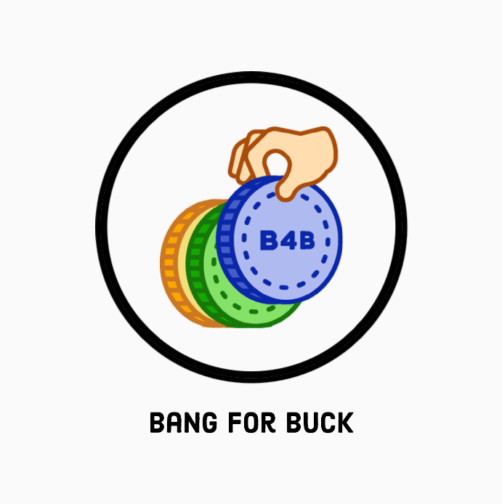

Number 4

